Slide 1
Relationships and
Repetition
Proven Success by a Seasoned GED Math Instructor

Slide 2
Introductory Fun Math
It’s Your Birthday!
Write the number of the month of your birthday. Example: January = 1, February = 2, March = 3, etc
Multiply this number by 5.
Add 7.
Multiply by 4.
Add 13.
Multiply by 5.
Add the day of your birth.
Share your answer to see if I can figure out what your birthday is from your answer.

Slide 3
Introductory Fun Math
Brothers and Sisters
1) Write down how many brothers you have.
2) Multiply by 2.
3) Add 1.
4) Multiply by 5.
5) Add the number of sisters you have.
6) Share your answer to see if I can figure out how many sisters and brothers you have.

Slide 4
Adult Learning Theory –
The andragogical model
4) Readiness to Learn: adults are ready to learn new material when their life has a need for it not only developmentally but in application. For example: a young couple is ready to take parenting classes when they learn they are expecting a baby.
5) Orientation to Learning: adults are motivated to learn new material when they perceive this subject matter to be of value and relevant to their current lives.
6) Motivation: Most adults are intrinsically motivated to learn new material even when external forces are at stake (e.g. a job promotion).
1) The Need to Know: adults need to understand the benefits of learning something new
2) The Learner’s Self-Concept: as educators, we can help learners move from dependency to self-directedness in their own learning.
3) The Role of the Learner’s Experiences: as educators we can emphasize individualization in the learning process and understand that each learner has their own past experiences that have led up to this educational moment.

Slide 5

First Day of Math Class is so IMPORTANT!
Provide a Syllabus
this outlines the calendar and activities as well as procedures, etc.
Set Expectations
attendance, homework, class structure etc.
Calm Their Fears
95% of my students over the years have had a negative experience in the math classroom setting
Give Them Encouragement
real life examples are helpful!

Slide 6
First Day of Math Class is so IMPORTANT!
Explain CASAS levels
  This is NOT the GED test
  40 hours to re-evaluation with a progress test
  Goal is Level 6
Math Curriculum Checklist
  Skills for the GED
  GED© Ready and other practice tests
Math class focuses on the computational skills
Each lesson builds on the day before
Word problems will help “train our brain” to read, evaluate, and solve for a particular question
Test taking strategies can be implemented on any test

Slide 7
Reflection
and redesign
are key to class
improvement
on the part of an
instructor.
How many of us are formally trained MATH teachers?
Share your struggles with your students.
Make mistakes – this is where the best learning happens!
“Learn together” – be honest.
Reflect – every day after class, take notes on what worked well and what didn’t. Use this to make changes for the better the next time around.

Slide 8
Relationships and Repetition
- Do you greet students by name?
Building rapport can make it or break it in determining if students will continue
Do you know their background – their job, family, motivation for coming to class?
Having this understanding of your student will help you in providing relevant examples (connecting the curriculum) in class. Students want information that is easily understood (common language) and applicable to their daily lives.
Do you foster a community in the classroom? Do you have conversations that everyone can relate to and want to be involved?
Better retention if student feels recognized, understood, “seen”.

Slide 9
Relationships and Repetition
Daily class structure is the same: review of the previous lesson, teach the new concept, students practice with the problems.
I learned to be consistent with the specific words I use to teach math
For example, I ask the class everyday what a fraction is…
Because this is the basic foundation of algebra, students need to know that a fraction is a part of a whole. More specifically, it’s a Part DIVIDED by a Whole
These words are building the foundation for every other skill in math- decimals, geometry, algebra, etc
Algebraic equations – what you do on one side of the equal sign, you must do to the other.
Everyday I teach a lesson, WE work through it together, THEY get time to practice the concept while I help provide feedback or re-teaching
    I do, WE do, THEY do approach
    Consistency in class structure helps with the repetition required to “cement” the learning

Slide 10
Don’t re-invent the wheel – I’m happy to share my materials with you
Daily lesson plans from whole numbers through Algebra, curriculum inventory checklist
Example of class syllabi
Student curriculum checklist – they track their own learning
Helper sheets – single pages of rules for numerous lessons: fractions, decimals, percents, order of operations, exponents, algebraic equations, geometry definitions, quadratic equations, etc
Test taking strategies – specific to math and then transferable to any subject

Slide 11
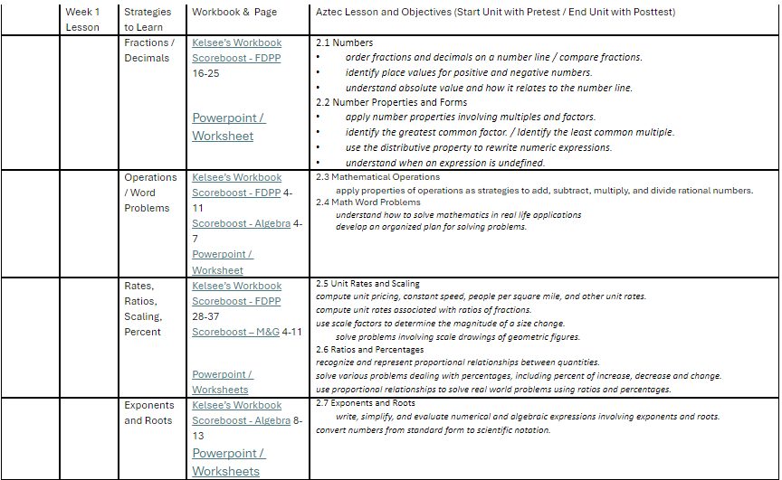
Stefan’s Overview – Crossover Table of Aztec/Workbook/PowerPoint for GED

Slide 12
Relationships and
Repetition
Proven Success by a Seasoned GED Math Instructor
Kelsee Rodabaugh: krodabaugh@mccneb.edu
Stefan Becker: sbecker8076@mccneb.edu

